Slide 1
Somatic Mutation Calling
Slides by Eric T. Dawson
November 2023
Updated: March 2025

Slide 2
Goals and learning outcomes
Develop a basic understanding of:
how variant callers produce calls and
how to perform variant calling
Deeply understand the workflow for variant calling
Start developing an intuition for working with variant calls
Every study will be different – it is better to learn ways of thinking than hard rules
Every study will require critical thought I want you to leave with a sense for how to ask the right questions, rather than give you the right answers (because they will be different for your data).
Learn common metrics used for quality control of tumors and their importance
Cancer Cell Fraction, Variant Allele Frequency, Tumor Purity, Copy Number, Contamination

Slide 3
Human mutation
Mutations are:
Changes in the DNA
Caused by exogenous or endogenous processes
Sometimes but not always heritable
Types of mutation:
Single nucleotide variants (SNVs)
Insertion-deletion variants (indels)
Structural variants (SVs)
These can be very complex!

Slide 4
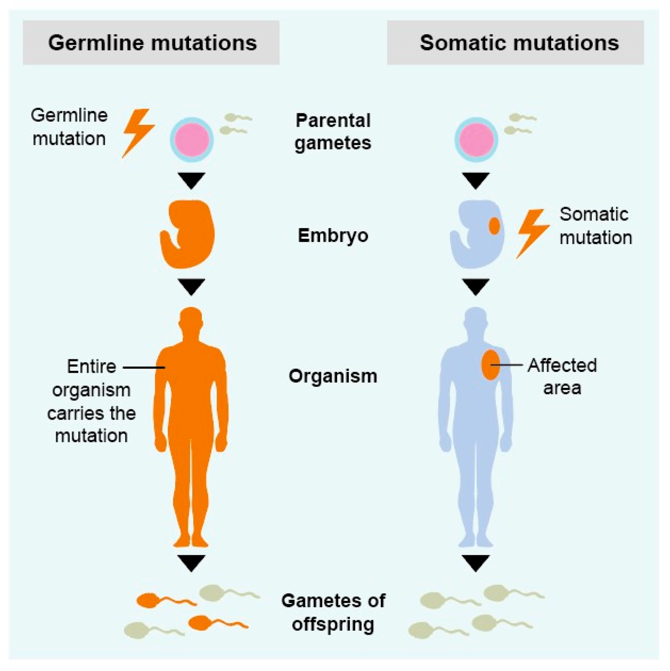
Somatic mutations
Somatic mutations occur in cells after fertilization which do not belong to the germline.
Somatic mutations may occur in almost any cell in the body.
In contrast to germline mutations, somatic mutations are never passed on to future generations.
https://www.mdpi.com/1422-0067/22/1/336/htm

Slide 5
Knowledge Check
Why aren’t somatic mutations passed on to future generations?
Are germline mutations always passed on to the next generation?

Slide 6
Types of Somatic Mutations
We use slightly different naming for the same mutation types to differentiate between germline and somatic variation
Simple Somatic Variants (SSVs)
Single-nucleotide and multi-nucleotide variants
Indels
Somatic Structural Variants
“Simple” types: deletions, insertions, inversions and duplications
Compound types (e.g., inverted duplications)
Complex types (e.g., chromoplexy, chromothripsis)

Slide 7
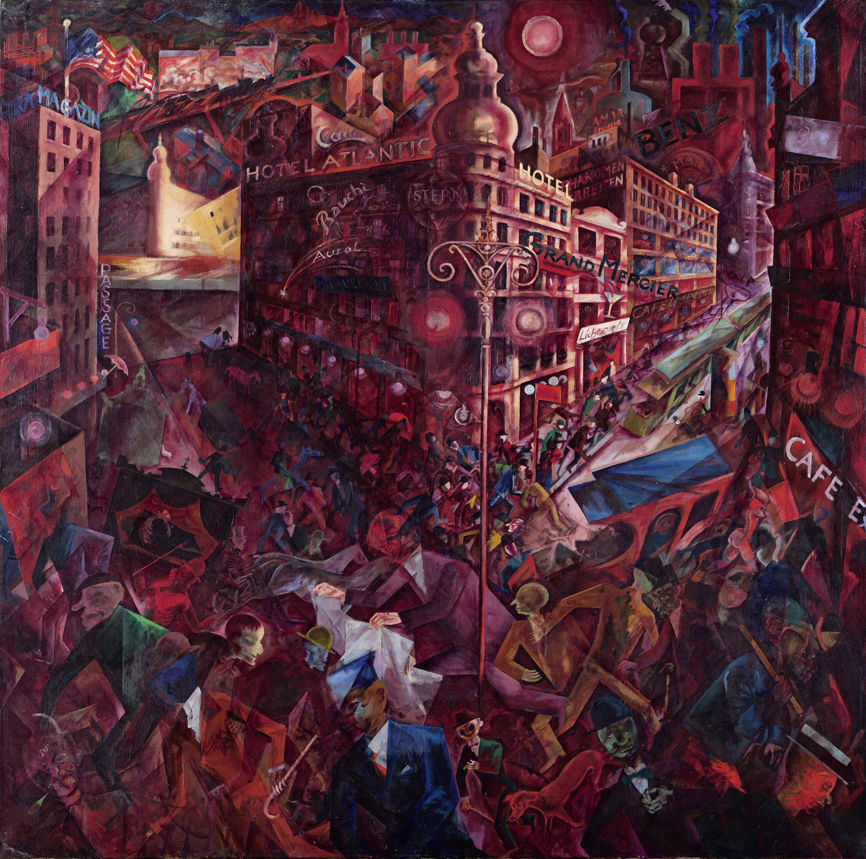

Somatic Tissues are Populations
Manifestacion by Antonio Berni
1934, MALBA
Metropolis by George Grosz
1916

Slide 8
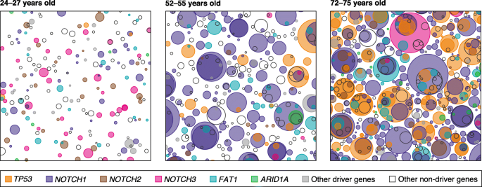
Somatic Clonal Expansion
time
An illustration of mutant cell colonization of healthy esophageal epithelium with age, from (Martincorena 2019). Normal tissues contain diverse populations of cells with distinct somatic ancestries.

Slide 9



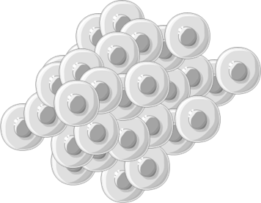

Cancer develops over time
A tumor diagnosed today likely arose from a mutant cell years to decades ago.
Even slight differences in growth rates over time can lead to dramatic shifts in population fraction.

Slide 10
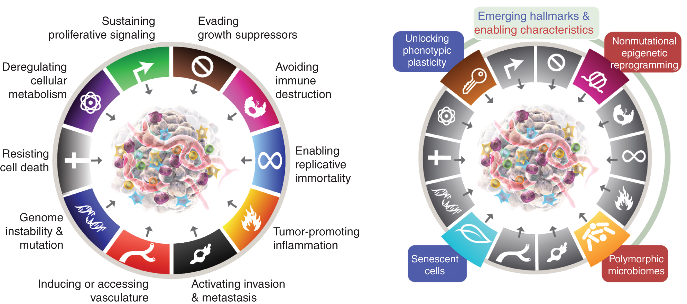
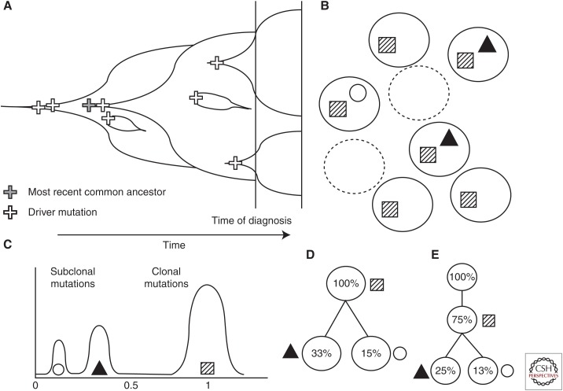
Tumor evolution
https://www.ncbi.nlm.nih.gov/pmc/articles/PMC5538405/
Hallmarks of Cancer: New Dimensions. Hanahan 2022
Notes:
TODO: update this

Slide 11

Mutation Calling
How do we get from this mess of cells to VCF files?
What do we need to consider along the way?
(Hint:) Why did I put the last few slides in?

Slide 12
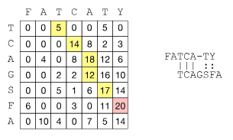

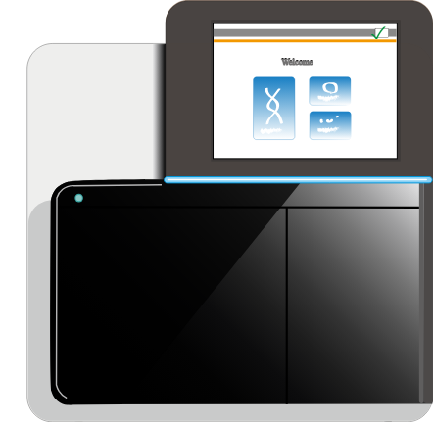

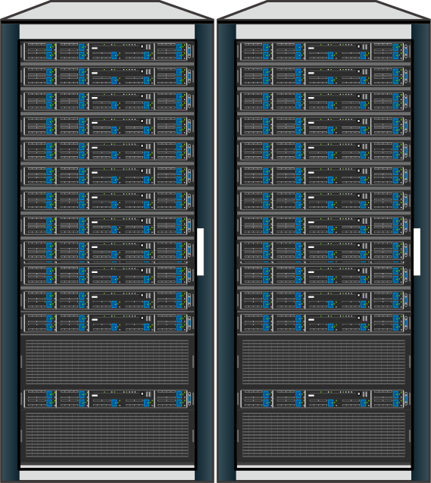

Mutation Calling
Library Prep
Sequencing
Alignment
Variant Calling
How do we get from this mess of cells to VCF files?
What do we need to consider along the way?
(Hint:) Why did I put the last few slides in?

Slide 13
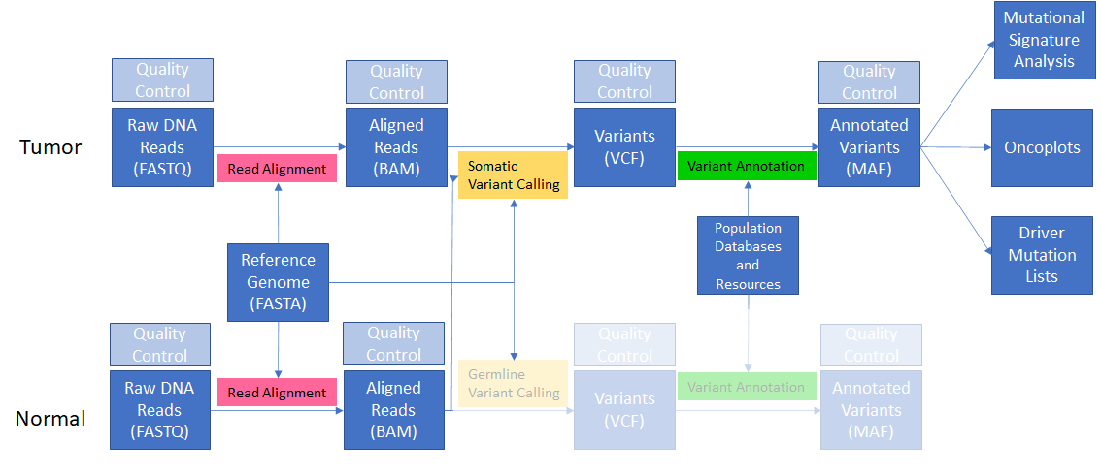
Bioinformatic Pipeline for a Somatic Study
Notes:
Remember from yesterday that we can’t do much with our raw FASTQ reads - we need to align them to the genome to have a meaningful understanding of what the genome of our tumor and normal actually look like.

Slide 14
Remember:
Mutations are called relative to a reference genome – changing references changes mutation calls.
Rule of thumb: every human germline differs every ~1000bp compared to the reference (“variation”). Usually 100-10000x fewer somatic mutations.
Younger tumors tend to have fewer mutations (pediatric tumors <10 is very common).
“Mutation” term is often reserved for variants with impact (e.g. driver mutations) or small variants.
To call somatic mutations, a somatic variant caller does the following:
Determine if a given site differs from the reference in the tumor and normal separately
Determine the allele and genotype of the site in the separate tumor / normal
Classify the site as “germline” or “somatic” by filtering any sites observed in both the tumor and normal
Sites that are observed in the tumor, but not the normal, are considered somatic variants.

Slide 15
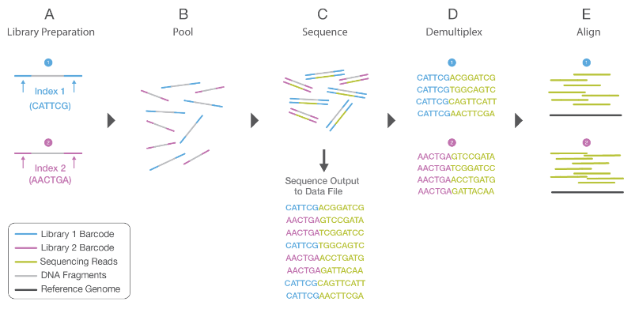
Read alignment
Remember - we have no idea where in the genome our FASTQ reads came from!
We can only sequence small (150bp) portions of the genome
We must “shatter” the DNA into sequenceable pieces (but these are random bits of DNA)
We then align them using seed-extend-align algorithms
Notes:
Image from https://www.illumina.com/content/dam/illumina-marketing/documents/products/illumina_sequencing_introduction.pdf

Slide 16
Read alignment
In read alignment, we probabilistically assign the random DNA fragments (“reads”) to a position within the reference genome.
CHR1
Align reads
CHR2
Reference genome w/ aligned reads
For a full discussion of sequence alignment, see: https://github.com/WCSCourses/NGS_Bio_Africa/blob/main/Modules/Module_4_Alignment_to_Reference/read-alignment.lecture_slides.20210504.pdf

Slide 17
Alignment: Seed – Chain - Extend
ACTTGCGTTGCCATTTGGGCACATTGGAATTCCAAGGGGGAAATTTGGGTTAACCCAAATTGGAATTGGTTAAT
Indexed Reference
Seed
TTGGCCACATTGGACTTCCAAGGCGG
Identify matches between read and reference.
Sequencing read
TTGGCCACATTGGACTTCCAAGGCGG
Chain
Identify runs of matches to help pinpoint the best-matching portion of the reference.
TTGGCCACATTGGACTTCCAAGGCGG
Extend (align)
TTGGCCACATTGGACTTCCAAGGCGG
Generate the exact alignment (think of the CIGAR string in a BAM)

Slide 18
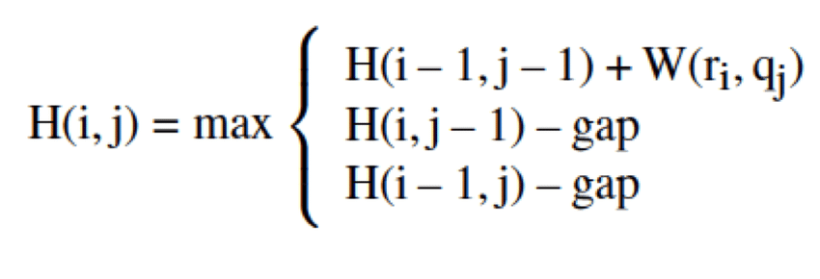
Read Alignment - Reference Bias
When we align reads, we penalize mismatches (SNPs and indels) relatively to the reference (that is, reads that perfectly match the reference score higher than those with variants).
But humans all vary from the reference.
This leads to reference bias:
Samples that are more like the human genome will have more accurate alignments and variant calls.
In addition - most databases are overwhelmingly filled with samples of European ancestry, so we continue to reinforce such bias downstream.
From Turakhia et al., 2017

Slide 19
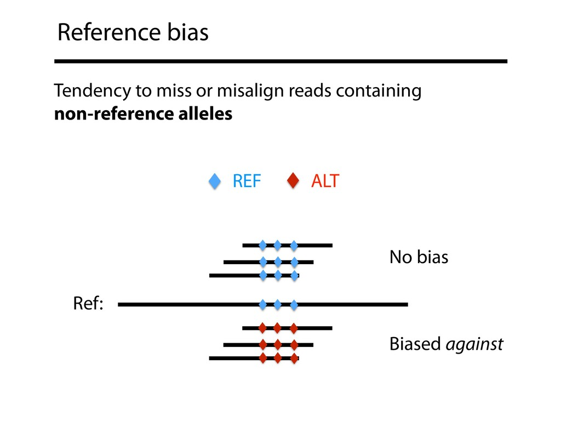
Reference Bias
From Ben Langmead: https://speakerdeck.com/benlangmead/advances-in-pan-genomics-for-addressing-reference-bias

Slide 20
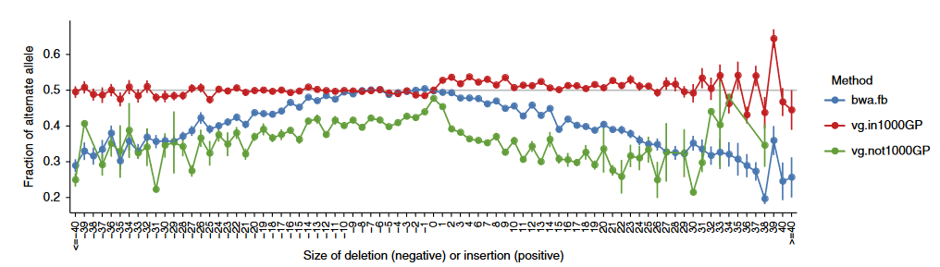
Reference Bias

Slide 21
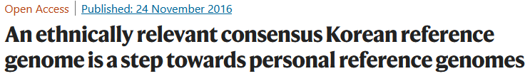
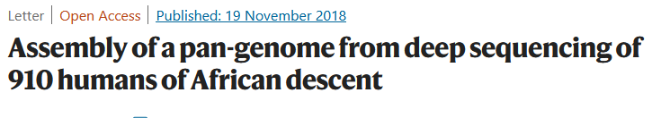
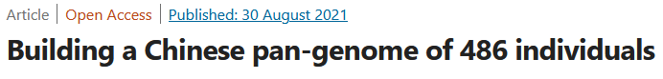
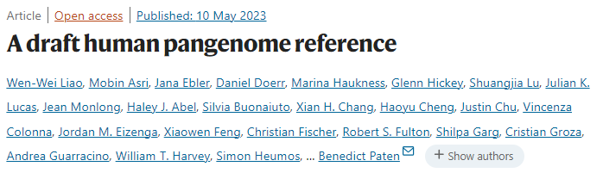
Read Alignment - Reference Bias
What are some things being developed to reduce reference bias?
Databases that include samples of diverse ancestry
NIH All of Us, Simons Genome Diversity Project, many national-level sequencing initiatives.
Population matched references
Useful for improved germline and somatic calls
HOWEVER, using one makes it difficult to use existing databases (so not a great answer)
Pangenomes
Pangenomes collect multiple genomes within a single data structure - imagine a reference that contains sequences/variation from many humans.
Over time, the field is migrating to these to address issues of inclusion in genomic studies.
Tools for using pangenomes exist and are growing in usage but not yet widespread.
But – our annotations are often not updated and still biased to hg19/38
For more information, see: https://humanpangenome.org/

Slide 22
Variant Calling
Definition: probabilistically assign alleles and genotypes to variant sites in the genome relative to a reference.

Slide 23
Variant Calling
ACTTGCGTTGCCATTTGGGCACATTGGAATTCCAAGGGGGAAATTTGGGTTAACCCAAATTGGAATTGGTTAAT
TTGGCCACATTGGACTTCCAAGGCGG
Imagine we considered just the mismatches between our many aligned reads and the reference.
How might we build a statistical model to classify each mismatch as:
Real / false positive
Germline / Somatic

Slide 24
Variant Calling Software
Variant callers use various mathematical methods to call variants, genotype calls, and produce quality metrics:
Heuristic methods (samtools mpileup + bcftools call)
Bayesian probability (Mutect2)
Deep learning (DeepVariant, DeepSomatic, Clair3)
There are probably hundreds of germline and somatic variant callers, but some of the most popular are:
Germline: GATK HaplotypeCaller, DeepVariant, bcftools, strelka2
Somatic: GATK mutect2, strelka2, MuSE, loFreq, DeepSomatic
Often, running multiple variant callers produces better results than a single caller (see the GDC pipeline for an overview of one such approach)
Notes:
TODO: Bayes Theorem Slide. We will focus our attention on mutect2 in the following slides on somatic variat calling, as it is popular, full-featured, and sensitive / precise

Slide 25
MuTect2
MuTect2 is a somatic variant caller that
Leverages the assembly approach of HaplotypeCaller
Applies a Bayesian classifier to detect low-allele fraction mutations
Uses a set of strict filters to increase specificity
Originally published in 2013; Updated Publication Here
Pros:
Included in the GATK
Widely used
Good support for panel of normals
Repeatedly validated in studies and competitions
Cons:
Very slow (but accelerated alternatives available)
Imperfect (like all variant callers) – calls still need to be filtered and curated

Slide 26
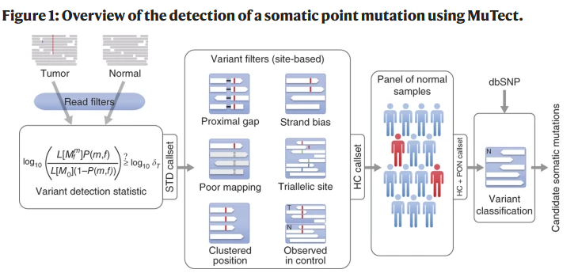
Mutect2
Prefiltering
Bayesian Classifier
Post
filtering
Population / database postfiltering (optional, but very powerful)

Slide 27
Mutect2
Basic usage:
gatk Mutect2 \
-R reference.fa \
-I tumor.bam \
-I normal.bam \
-normal normal_sample_name \
-O somatic.vcf.gz
Q: What are the inputs to Mutect2?

Slide 28
Panel of Normals
We often use a panel of normal samples (or PON) to remove germline mutations from our somatic calls.
PON: A collection of normal samples we use for filtering
Two types: Population PONs and Study PONs
Population PONs tend to contain germline variants from many samples
Many, many variants, so you can remove more common variants in somatic data
Often 1000Genomes, gnomAD, or Simons Genome Diversity Project
Study-matched PONs are more specific to your population, so they’re useful particularly for populations that aren’t well represented in databases.

Slide 29
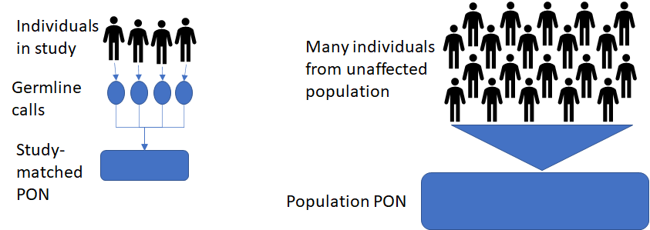
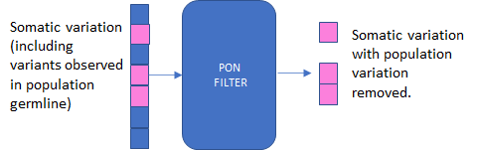
Mutect2 - Panel-of-Normals (PON)

Slide 30
Mutect2 - PON
Usage with germline resource + PON:
gatk Mutect2 \
-R reference.fa \
-I tumor.bam \
-I normal.bam \
-normal normal_sample_name \
--germline-resource af-only-gnomad.vcf.gz \
--panel-of-normals pon.vcf.gz \
-O somatic.vcf.gz
Creating a PON:
Call normal samples in tumor-only mode
Create a PON using mutect
or
Download a public PON

Slide 31
Mutect2 - PON
Tumor-only mode (used to create PON):
gatk Mutect2 \
-R reference.fa \
-I sample.bam \
-O single_sample.vcf.gz
Tumor only mode with PON + germline resource (for when you don’t have a matched normal):
gatk Mutect2 \
-R reference.fa \
-I sample.bam \
--germline-resource af-only-gnomad.vcf.gz \
--panel-of-normals pon.vcf.gz \
-O single_sample.vcf.gz

Slide 32
Mutect2 outputs
A VCF file of somatic variant calls
Important fields: DP, GQ, GT, VAF
Useful options:
--annotations <annotation> : add fields like DP (depth) to output
--annotation-group <annotation group> : add groups of fields to output

Slide 33
Mutect2
Mutect2 is very slow. Some ways to speed it up:
Split analysis across genomic intervals (standard way)
Add more threads (slight boost)
Use an accelerated version (e.g., Nvidia Clara Parabricks, Sentieon, etc.)

Slide 34
Mutect2
You’ll learn today to run Mutect2 locally using GATK, but:
You can run mutect2 in a workflow (e.g., NextFlow, SnakeMake, or WDL)
You can run it in the Cloud (.e.g. on Terra) (warning: can be expensive!)

Slide 35
Variant calling
Our aligned reads will have variation relative to the reference. When we call variants, we probabilistically assign alleles and genotypes to these variations based on the evidence provided by our alignments
Rules of thumb:
humans have a germline mutation on average every 1000 bp (99.9% identical)
SNPs are roughly 10x more frequent than indels (except in hypermutator genotypes like Microsatellite Instability)
While each tumor has a unique number of mutations, within each cancer type the number of observed somatic mutations is often remarkably consistent (e.g. in thyroid cancer hundreds of mutations, in colon cancer 1000s, etc.)
GAATTGGTCAAAAAT
CAAAAAT-CTTA
Aligned read(s):
TGGTCAAAAAT-C
Reference:
ACTGGAATGGCCAAAAATGCTTAAGGCCTTATGGAAATGGAATCCACCA

Slide 36
What types of variants might we find?
Single-nucleotide variants
Mutation substitutes a single basepair (e.g., C->T)
Multi-nucleotide variants
Two or more adjacent nucleotides are substituted (e.g. CC->TT)
Insertion-deletion variants
One or more nucleotides are inserted into or deleted from the reference (e.g. AATTGGCC -> AAT-GGCC and AATTGGCC -> AATTTTTGGCC)
Structural variants
Large (>50bp) changes to the genome that may alter copy number, orientation, chromosomal organization, etc.
CNVs

Slide 37
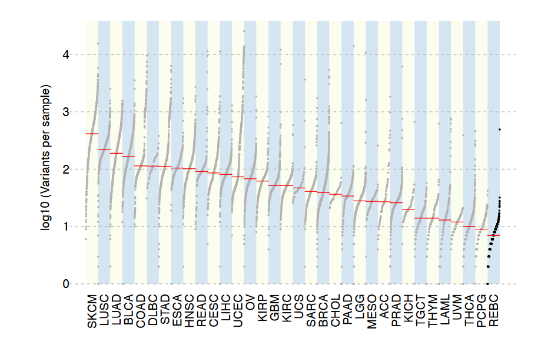
Somatic SNVs and Indels
Somatic single-nucleotide variants (sSNVs) and indels are sometimes collectively referred to as SSVs (simple somatic variants)
Every tumor will have some, but total count (“mutation burden”) can vary both within and across cancer types.
Generally, anywhere from <10 to tens-of-thousands of somatic mutations (vs. millions of germline variants)

Slide 38
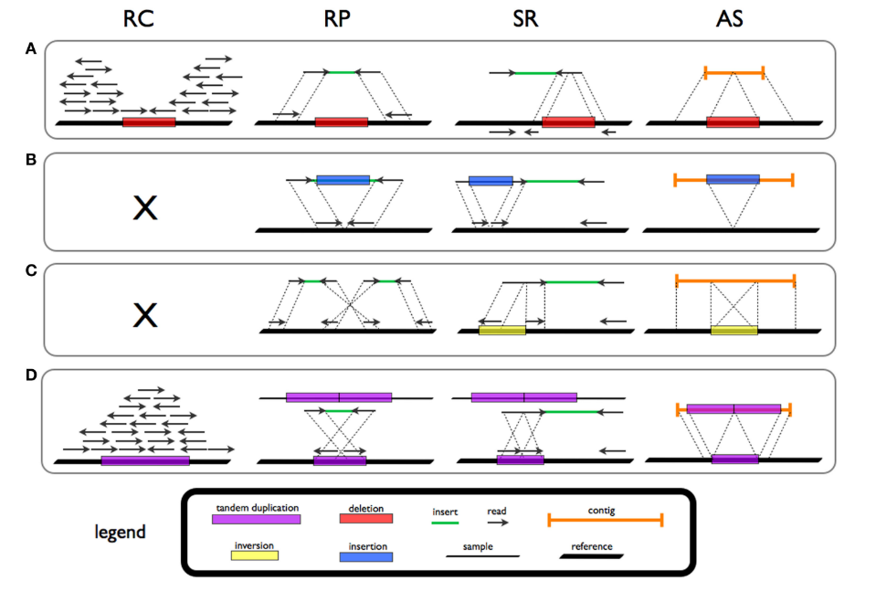
Structural variants
Structural variants are large (>50bp) alterations within the genome
Hard to detect in short reads
Historically undersurveyed in short-read studies
Occur more rarely than SSVs, but affect more basepairs of sequence
Incredibly powerful impacts on genome
Gene Fusions
Promoter swapping
Chromothripsis, kataegis, etc.
Short read callers: delly, lumpy, Manta, svaba
Long read callers: SNIFFLES2, PBSV
Types of structural variants and various evidence types (from Tattini et al 2015.)

Slide 39
Variant Calling
Rules of thumb:
Humans have a germline mutation on average every 1000 bp (99.9% identical)
*SNPs are roughly 10x more frequent than indels (except in hypermutator genotypes like Microsatellite Instability) in both germline and somatic calls.*
While each tumor has a unique number of mutations, within each cancer type the number of observed somatic mutations is often remarkably consistent (e.g. in thyroid cancer hundreds of mutations, in colon cancer 1000s, etc.)

Slide 40
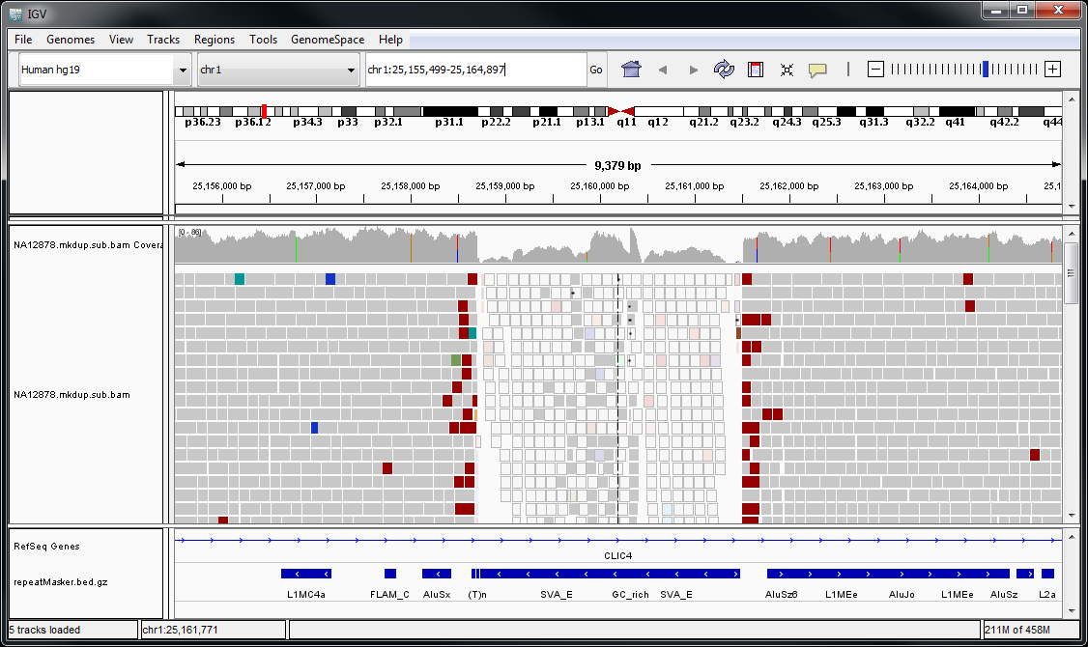
Integrated Genomics Viewer (IGV)
IGV is a program for viewing alignments (https://software.broadinstitute.org/software/igv/)

Slide 41
IGV
Select Genome
Zoom
Current window location
Coverage
Track
Read
Track
Annotation
Track

Slide 42
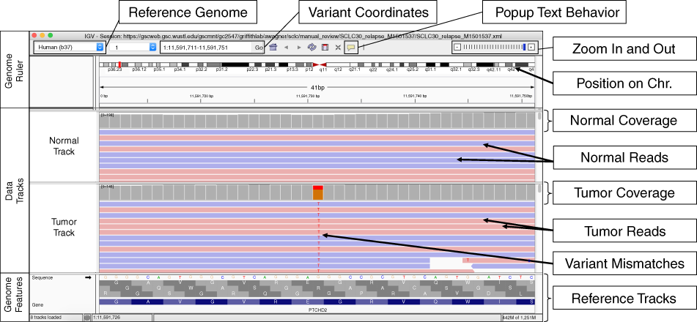
IGV
Useful paper:https://www.nature.com/articles/s41436-018-0278-z

Slide 43
Variant annotation
Variant calls alone tell us only where a variant occurred in the genome and the allele / genotype.
To assess a variant in the context of cancer, we want to know:
Its frequency in the unaffected population
Its frequency in cancer cases (from tumors of same/different type)
Its possible impact on gene expression
Its possible impact when translated to protein
Any association to disease
We annotate variants to link our calls with such information

Slide 44
Variant annotations
Where do annotations come from?
Gene and transcript databases (ENSEMBL, UCSC)
Population databases (1000Genomes, dbSNP, COSMIC, PCAWG, gnomAD)
Impact prediction software (SIFT, PolyPhen, MutationTaster, CADD, REVEL, dbNSFP)
Manual annotation (ClinVar, BRCA Exchange)
Aggregate Annotation Databases (VEP, wANNOVAR, Funcotator)

Slide 45
How do we annotate variants?
We use annotation software, which adds fields to our data
Examples:
Variant Effect Predictor (VEP)
Funcotator
VCF2MAF
Vcfanno
SNPSwift
Output: VCF or MAF (both tab-delimited files)

Slide 46
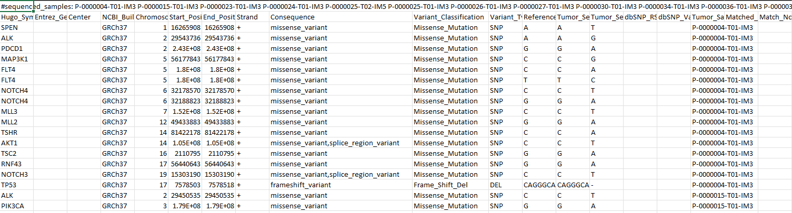
Annotation - important fields
Gene Name
Mutation Type
dbSNP ID
Variant Type

Slide 47
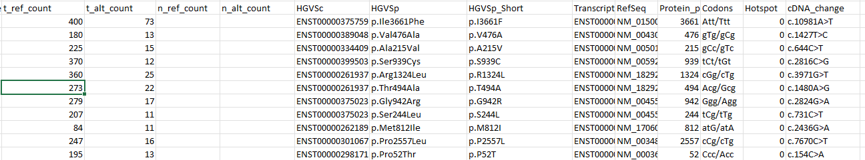
Annotation
More useful MAF columns:
Q: What do we do once we have annotated variants?
A: All the analyses we can actually publish!

Slide 48
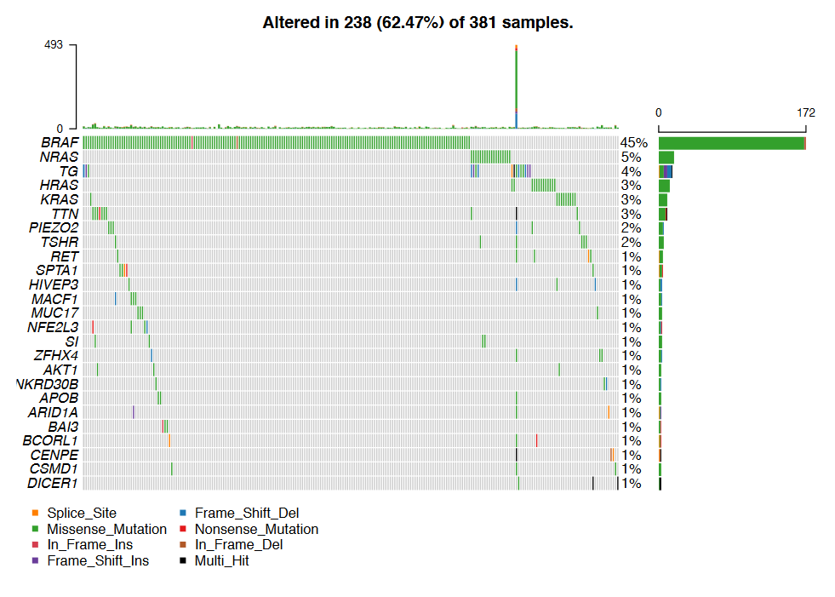
Annotation -> oncoplots
From Dawson 2020

Slide 49
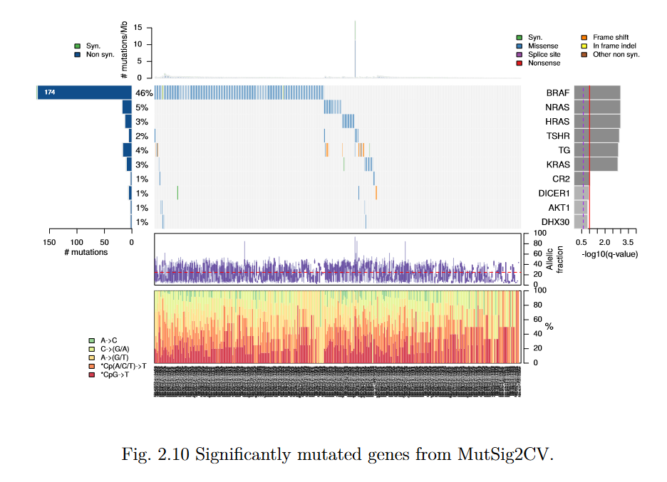
Annotation -> significantly mutated genes
From Dawson 2020

Slide 50
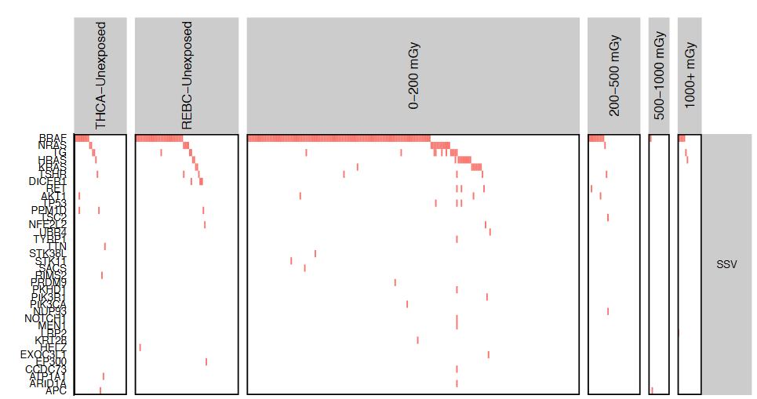
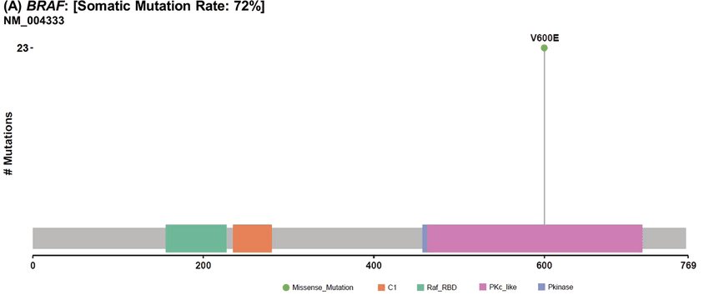
Annotations -> driver mutations
Modified from: https://link.springer.com/article/10.1007/s12020-019-01842-y
From Dawson 2020

Slide 51
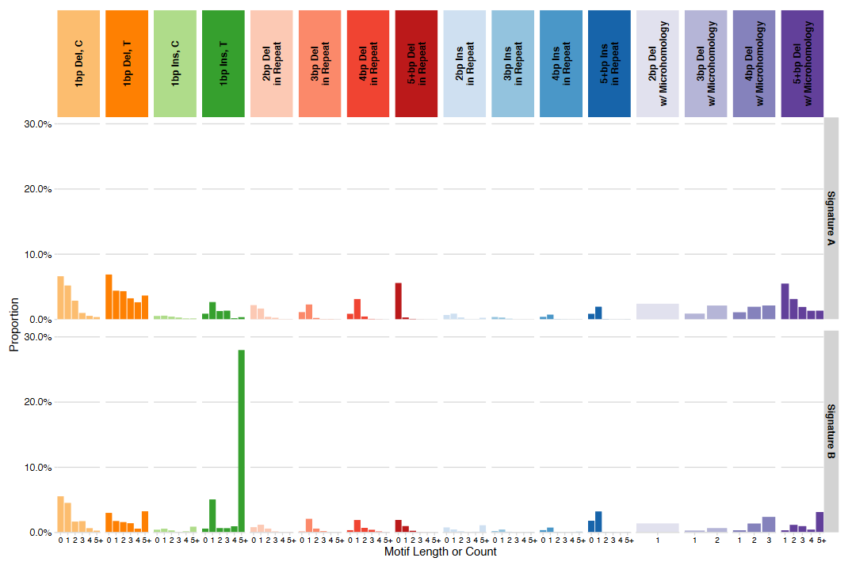
Annotations -> mutational signatures
From Dawson 2020

Slide 52
VAF, CCF, Tumor Purity, Copy Number, and Contamination
Tumors are complex, bulk mixtures of cells
Tumors continue to mutate while under constant evolutionary pressure
Significant benefits for developing faster growth, immune evasion, angiogenesis and other hallmarks of cancer (more about this in the Driver Mutations lecture)
May be composed of multiple subclones with complex architecture
A tumor is a cellular mixture of (sub)clones with various genetic mutations over a common background; normal cells; immune cells; etc.
Resected tumor

Slide 53
VAF: Variant Allele Frequency
The proportion of reads supporting a given allele at a site:
VAF = # Reads supporting alt
(# reads supporting alt) + (# reads supporting reference)
Simple! Except:
Not all tumor cells will contain a given mutation
Tumors are contaminated with normal cells
Copy number changes can change the ratio of alleles
Therefore, we can’t rely on VAF as an accurate descriptor of a tumor’s mutations (as we can for germline)

Slide 54
Cancer cell fraction (CCF)
CCF: the proportion of cells within a tumor containing a given variant (preferable to VAF)
Think of this as an allele fraction weighted to cells within the tumor
CCF = 1.0: all cells in the tumor have this mutation (“clonal”)
CCF = < 1.0: some proportion of cells in the tumor have this mutation (“subclonal”)
Common subclonal VAFs: 0.5, 0.33 (think of dividing the tumor)
Resected tumor
(total tumor cells: 18)
CCF = 5 / 18 = ~0.33 (subclonal)
CCF = 18 / 18 = 1 (possible driver)
CCF = ?? = ?? (clonal or subclonal?)

Slide 55
Tumor purity
Tumor purity: the percentage of cells in the “tumor” sample that are actually from the tumor.
We can’t easily extract tumors cell-by-cell - there is always some level of normal cell infiltration
Tumor purity: 18 / 23 ~78% (pretty good!)
Typical purity range: 20%-80%
Resected tumor
(Total cells: 23
total tumor cells: 18)

Slide 56
Contamination
Technical contamination from another sample (happens much more often than you might think)
Tumor-in-normal
contamination
Normal cell contamination
In tumor
Resected tumor

Slide 57
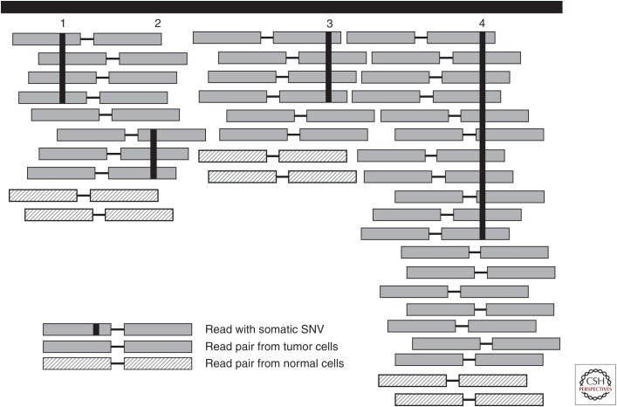
Copy Number Variation
Copy number = 1
(Ploidy = 2)
Copy number = 2
(Ploidy = 4)
Distorted VAF / CCF
Original CCF: 0.5
Original VAF: 0.5
One haplotype duplicated -> new VAF ~0.66
If you observe CCFs not divisible by 2, and your tumor is relatively pure, consider looking at copy number (e.g. with ASCAT)

Slide 58
Calling CNVs in Somatic Data
CNVs can be very important in cancer
Amplifying oncogenes
Deleting copies of tumor suppressors
Loss of heterozygosity
We usually call CNVs using Circular Binary Segmentation or similar methods
Large CNVs are easily validated by array data

Slide 59
Calling CNVs using Circular Binary Segmentation
Objective: Fit a number of depth states and transitions between them to the data
Reads
Estimated Depth State

Slide 60
Calling CNVs
Sequenza:
Code: https://bitbucket.org/sequenzatools/sequenza/src/master/
Paper: https://www.ncbi.nlm.nih.gov/pmc/articles/PMC4269342/
Tutorial available here

Slide 61
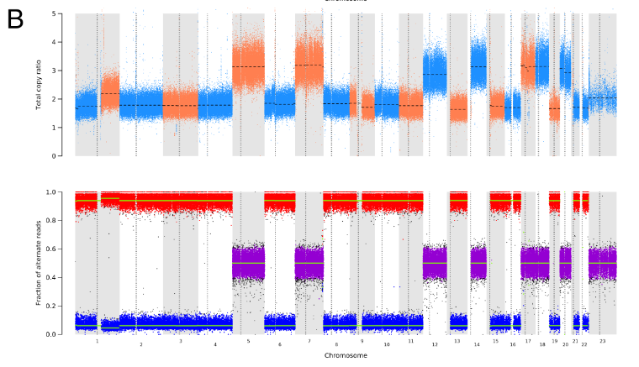
CNVs

Slide 62
Filtering Variants after Calling and Annotation
Variant callers, while good, are imperfect – expect regular false negatives and false positives!
How do we address incorrect calls?

Slide 63
Filtering Variants After Annotation
Filter on fields in the VCF / MAF and metrics calculated from these
AD, DP, GT and GQ (What do you think these fields are?)
CCF, VAF, TP
Field names can be found in the VCF header
They can also be calculated from other field names (e.g., VAF = AD / DP)
Review variants in IGV
Remove or keep variants based on annotations
Do iterative rounds of this filtering
Often, a few samples will be done in depth, and then a pipeline can be applied to the remaining samples in the study as a first-pass
We can use R, python, Excel, etc. to do the filtering.

Slide 64
Somatic VCF Fields
Field Tag | Field Name | Field Type | Description
AD | Allele Depth | integer
DP | Depth | integer
GT | Genotype | Genotype (string)
GQ | Genotype Quality | float
CCF | Cancer Cell Fraction | float
VAF | Variant Allele Frequency | float
TP | Tumor Purity | float

Slide 65
What are we doing when we filter variants?
Removing germline from our somatic calls
But, there are so many other ways to filter. How would we filter if we:
What if we have only a tumor sample?
What if we want to look for cancer predisposition mutations?
What if we only care about certain druggable mutations?

Slide 66
Filtering integrates internal and external data
Our biological sample
The variants in our sample(s)
External Data Sources
Tumor Mutations
Population PON
Germline Pop Database
Normal Mutations
Study PON
Resected tumor
Somatic Pop Database

Slide 67
Filtering is a bit like Variant Algebra
The variants in our sample(s)
External Data Sources
Tumor Mutations
Population PON
Germline Pop Database
Normal Mutations
Study PON
Somatic Pop Database

Slide 68
Filtering as Variant Algebra
Tumor Mutations
?
Normal Mutations
Germline Pop Database
?
Normal Mutations
?
Known Driver Mutations
Tumor Mutations
Normal Mutations
Germline Pop Database

Slide 69
Filtering as Variant Algebra
Tumor Mutations
Normal Mutations
Somatic Mutations
Normal Mutations
Germline Pop Database
Private/rare germline mutations
(incl. predisposition variants)
Known Driver Mutations
Tumor Mutations
Normal Mutations
Germline Pop Database
Somatic Mutation Database

Slide 70
How would we filter the following?
Cancer Predisposition Variants
Novel Driver Mutations in our sample
Somatic mutations that aren’t drivers
Why might we want to look for these?
Population PON
Tumor Mutations
Germline Pop Database
Study PON
Somatic Pop Database
Normal Mutations
Notes:
Somatic mutations, not drivers: mutational signatures e.g. environmental exposures

Slide 71
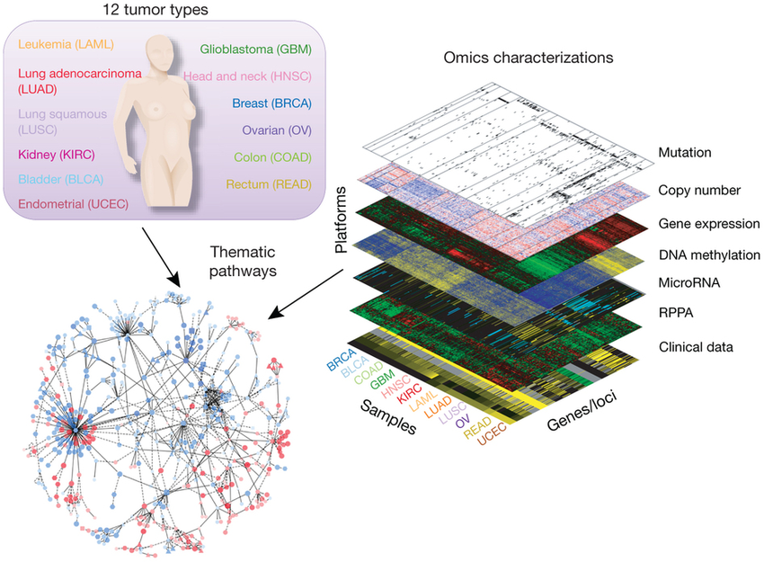
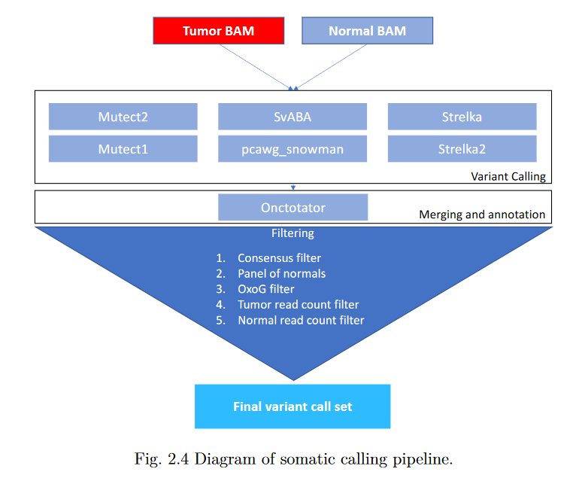
Filtering by integrating calls
Integrating across technologies
Integrating across callers

Slide 72
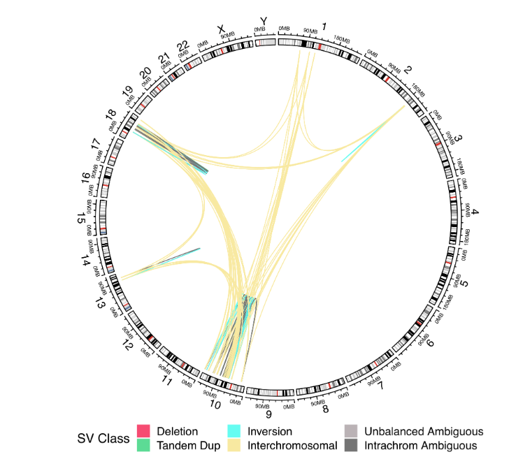
Validating across variant types

Slide 73
Remember: this is part of a bigger pipeline

Slide 74
Conclusions
If you just want to get SSV calls: BWA mem + MuTect2
Variant calls are almost useless without annotation
Filter your calls extensively
Tumors are complex, and somatic calling is full of sources of error
Be careful, think statistically, and consider common sources of error
Expectations from one study (e.g., SSV burden) may or may not apply in others

